Slide 1
Statistical Machine Learning-
The Basic Approach and
Current Research Challenges
Shai Ben-David
CS497
February, 2007

Slide 2
A High Level Agenda
“The purpose of science is
to find meaningful simplicity
in the midst of disorderly complexity”
Herbert Simon

Slide 3
Representative learning tasks
Medical research.
Detection of fraudulent activity
(credit card transactions, intrusion detection, stock market manipulation)
Analysis of genome functionality
Email spam detection.
Spatial prediction of landslide hazards.

Slide 4
Common to all such tasks
We wish to develop algorithms that detect meaningful regularities in large complex data sets.
We focus on data that is too complex for humans to figure out its meaningful regularities.
We consider the task of finding such regularities from random samples of the data population.
We should derive conclusions in timely manner. Computational efficiency is essential.

Slide 5
Different types of learning tasks
Classification prediction –
we wish to classify data points into categories, and we are given already classified samples as our training input.
For example:
Training a spam filter
Medical Diagnosis (Patient info → High/Low risk).
Stock market prediction ( Predict tomorrow’s market trend from companies performance data)

Slide 6
Other Learning Tasks
Clustering –
the grouping data into representative collections
- a fundamental tool for data analysis.
Examples :
Clustering customers for targeted marketing.
Clustering pixels to detect objects in images.
Clustering web pages for content similarity.

Slide 7
Differences from Classical Statistics
We are interested in hypothesis generation rather than hypothesis testing.
We wish to make no prior assumptions
about the structure of our data.
We develop algorithms for automated generation of hypotheses.
We are concerned with computational efficiency.

Slide 8
Learning Theory:
The fundamental dilemma…
Tradeoff between accuracy and simplicity
y=f(x)
Y
Good models should enable Prediction of new data…
X

Slide 9
A Fundamental Dilemma of Science:
Model Complexity vs Prediction Accuracy
Limited data
Accuracy
Possible Models/representations
Complexity

Slide 12
Problem Outline
We are interested in
(automated) Hypothesis Generation,
rather than traditional Hypothesis Testing
First obstacle: The danger of overfitting.
First solution:
Consider only a limited set of candidate hypotheses.

Slide 13
Empirical Risk Minimization Paradigm
Choose a Hypothesis Class H of subsets of X.
For an input sample S, find some h in H that fits S well.
For a new point x, predict a label according to its membership in h.

Slide 14
The Mathematical Justification
Assume both a training sample S and the test point (x,l) are generated i.i.d. by the same distribution over
X x {0,1} then,
If H is not too rich ( in some formal sense) then,
for every h in H, the training error of h on the sample S is a good estimate of its probability of success on the new x .
In other words – there is no overfitting

Slide 15
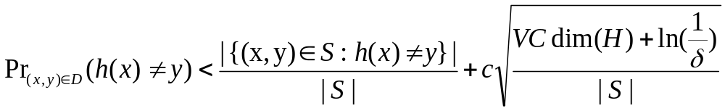
The Mathematical Justification - Formally
If S is sampled i.i.d. by some probability P over X×{0,1}
then, with probability > 1-δ, For all h in H
Expected test error
Training error
Complexity Term

Slide 16
The Types of Errors to be Considered
Training error minimizer
Best regressor for P
Best h (in H) for P
The Class H
Total error
Approximation Error
Estimation Error

Slide 17
The Model Selection Problem
Expanding H
will lower the approximation error
BUT
it will increase the estimation error
(lower statistical soundness)

Slide 18
Yet another problem –
Computational Complexity
Once we have a large enough training sample,
how much computation is required to search for a good hypothesis?
(That is, empirically good.)

Slide 19
The Computational Problem
Given a class H of subsets of R^{n}
Input: A finite set of {0, 1}-labeled points S in R^{n}
Output: Some ‘hypothesis’ function h in H that
maximizes the number of correctly labeled points of S.

Slide 20
Hardness-of-Approximation Results
For each of the following classes, approximating the
best agreement rate for h in H (on a given input
sample S ) up to some constant ratio, is NP-hard :
Monomials Constant width
Monotone Monomials
Half-spaces
Balls
Axis aligned Rectangles
Threshold NN’s
BD-Eiron-Long
Bartlett- BD

Slide 21
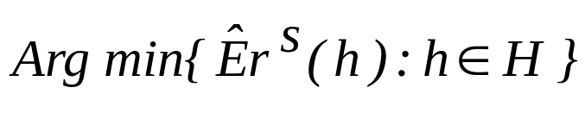

The Types of Errors to be Considered
Output of the the learning Algorithm
Best regressor for D
The Class H
Approximation Error
Estimation Error
Computational Error
Total Error

Slide 22
Our hypotheses set should balance several requirements:
Expressiveness – being able to capture the structure of our learning task.
Statistical ‘compactness’- having low combinatorial complexity.
Computational manageability – existence of efficient ERM algorithms.

Slide 23
Concrete learning paradigm- linear separators
h
The predictor h:
Sign ( w_{i} x_{i}+b)
(where w is the weight vector of the hyperplane h,
and x=(x₁, …x_{i},…x_{n}) is the example to classify)

Slide 24
Potential problem – data may not be linearly separable

Slide 25
The SVM Paradigm
Choose an Embedding of the domain X into
some high dimensional Euclidean space,
so that the data sample becomes (almost)
linearly separable.
Find a large-margin data-separating hyperplane
in this image space, and use it for prediction.
Important gain: When the data is separable,
finding such a hyperplane is computationally feasible.
Notes:
Boosting may be viewed as “hoping/pretending that the world is nice” (PAC assumption)
SVMs say “the world may not be nice when we start, but we’ll turn it into a nice enviroment”

Slide 26
The SVM Idea: an Example
Notes:
Consider the mapping x maps to (x, x)

Slide 27
The SVM Idea: an Example
x ↦ (x, x²)
Notes:
Consider the mapping x maps to (x, x)

Slide 28
The SVM Idea: an Example
Notes:
Consider the mapping x maps to (x, x)

Slide 29
Controlling Computational Complexity
Potentially the embeddings may require very high Euclidean dimension.
How can we search for hyperplanes efficiently?
The Kernel Trick: Use algorithms that depend only on the inner product of sample points.

Slide 30
Kernel-Based Algorithms
Rather than define the embedding explicitly, define just the matrix of the inner products in the range space.
........
K(x₁x₁) K(x₁x₂)
K(x₁x_{m})
.......
K(x_{i}x_{j})
.......
............
K(x_{m}x₁)
K(x_{m}x_{m})
Mercer Theorem: If the matrix is symmetric and positive semi-definite, then it is the inner product matrix with respect to some embedding

Slide 31
Support Vector Machines (SVMs)
On input: Sample (x₁ y₁) ... (x_{m}y_{m}) and a kernel matrix K
Output: A “good” separating hyperplane

Slide 32
A Potential Problem: Generalization
VC-dimension bounds: The VC-dimension of
the class of half-spaces in R^{n} is n+1.
Can we guarantee low dimension of the embeddings range?
Margin bounds: Regardless of the Euclidean dimension, generalization can bounded as a function of the margins of the hypothesis hyperplane.
Can one guarantee the existence of a large-margin separation?

Slide 33
The Margins of a Sample
h
max min w_{n} ⋅ x_{i}
separating h x_{i}
(where w_{n} is the weight vector of the hyperplane h)

Slide 34
Summary of SVM learning
The user chooses a “Kernel Matrix”
- a measure of similarity between input points.
Upon viewing the training data, the algorithm finds a linear separator the maximizes the margins (in the high dimensional “Feature Space”).

Slide 35
How are the basic requirements met?
Expressiveness – by allowing all types of kernels there is (potentially) high expressive power.
Statistical ‘compactness’- only if we are lucky, and the algorithm found a large margin good separator.
Computational manageability – it turns out the search for a large margin classifier can be done in time polynomial in the input size.

